Slide 1
Computational model of cancer stem cell dynamics
Submitted By
Rahul Kulkarni
CE, Dept of CS & E,
SJCE, Mysore.
Internal Guide
Dr.M.A.Anusuya
Assistant Professor,
Dept of CS & E,
SJCE, Mysore.
Panel
Mrs. Manjula.S
Assistant Professor,
Dept of CS & E,
SJCE, Mysore.
External Guide
Dr.Shamik.Sen
Assistant Professor,
Dept of BS & BE,
IIT B, Mumbai.

Slide 2
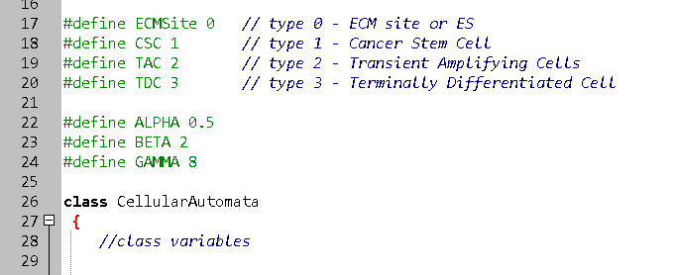
DESCRIPTION OF THE WORK
Cell types to simulate:
CSC
TAC
TDC
ES

Slide 3
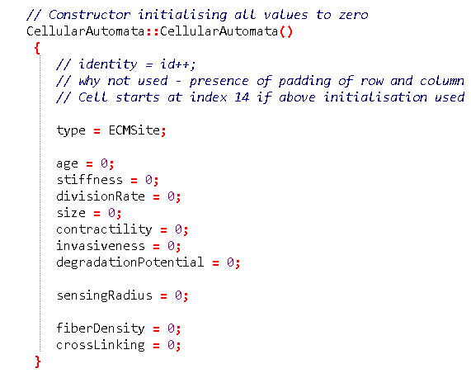
DESCRIPTION OF THE WORK
Cell properties:

Slide 4
DESCRIPTION OF THE WORK
The rules to update the state of cells are based on parameters:
α : P( CSC dividing into TAC )
1 - α : P( CSC dividing into CSC )
β : Number of divisions of TAC ( after which they transform into TDC )
γ : Life time of TDC

Slide 5

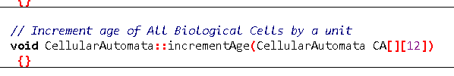


DESCRIPTION OF THE WORK

Slide 6
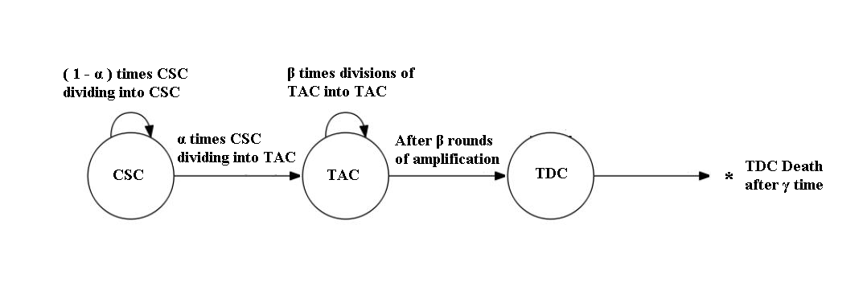
DESCRIPTION OF THE WORK

Slide 7
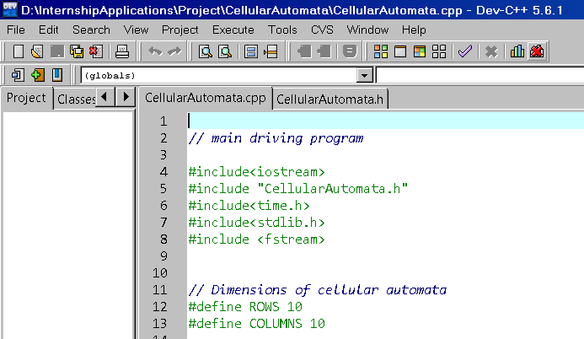
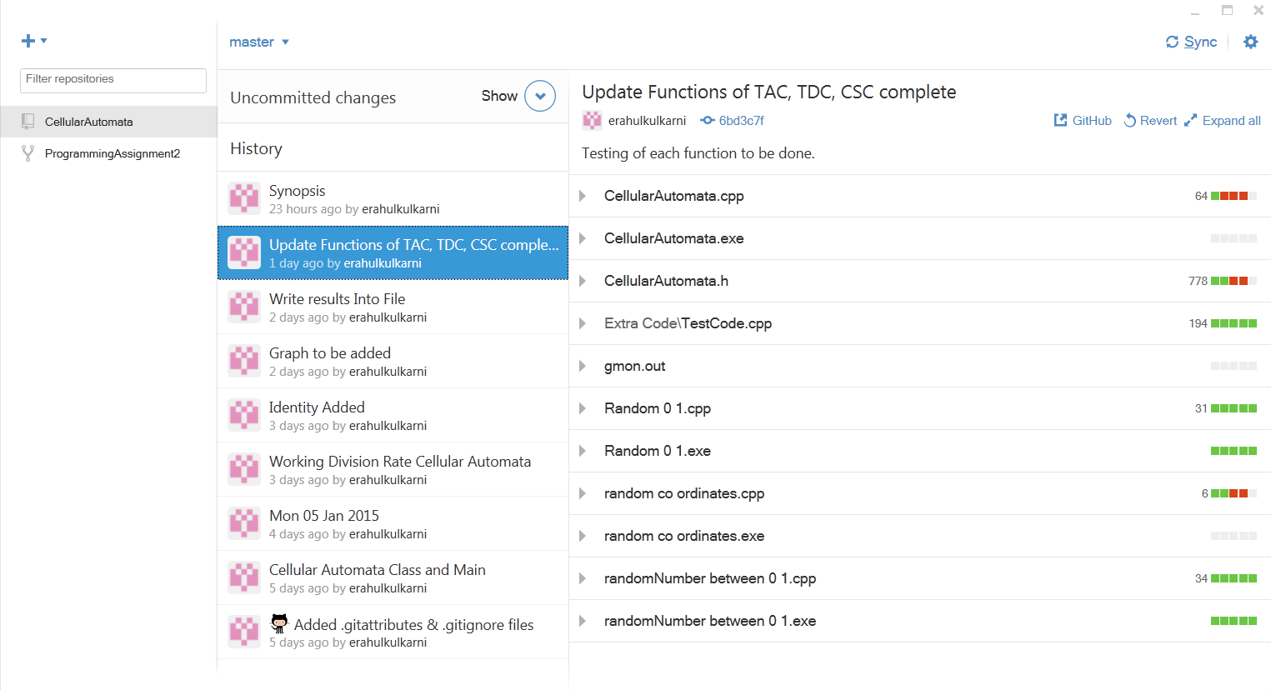
DESCRIPTION OF THE WORK

Slide 8
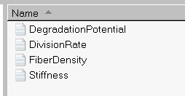
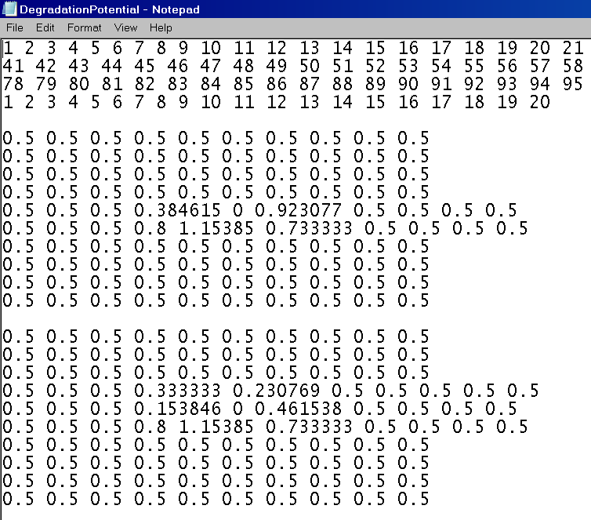
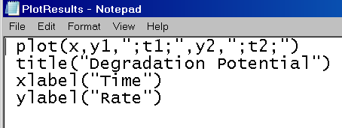
DESCRIPTION OF THE WORK

Slide 9
THANK YOU

